Slide 1
Use of USDA Insurance Programs to Protect Dairy Margins: A Comparison of the Alternatives
Prof. Brian W. Gould
Department of Agricultural and Applied Economics
University of Wisconsin-Madison
University of Wisconsin Extension
October 28 – 30, 2014
www.dairymarkets.og/MPP/PowerPoint

Slide 2
Dairy Marketing and Policy
(DMaP) Group
Inter-university group of dairy economists
  Cornell University: A. Novakovic
  Michigan State University: C. Wolfe
  The Ohio State University: C. Thraen
  Penn. State University: C. Nicholson
  University of Illinois: J. Newton
  University of Minnesota: M. Bozic
  University of Wisconsin: M. Stephenson &
  B.W. Gould
Multi-year agreement with USDA’s, Farm Service Agency to provide MPP educational programming and decision software development

Slide 3

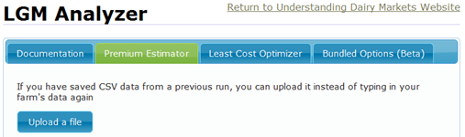

Alternative Dairy Margin Risk Management Systems
What are some alternative systems for managing dairy Income Over Feed Cost margins?
  Forward contracting milk and feed
    2008 & 2014 Farm Bills: Dairy cooperatives/private plants can offer forward prices (except Class I milk)
  Traditional use of futures and options
    Convert feed requirements to per cwt of milk basis
  Aug 2008: Livestock Gross Margin for Dairy (LGM)
  Sep 2014: Margin Protection Program for Dairy (MPP)

Slide 4

Livestock Gross Margin-Dairy: An Overview
LGM used to manage margin (IOFC) volatility by establishing IOFC floor
  No futures or options purchased
  No minimum size limit
  Coverage upper limit: 240,000 cwt over 10 mo. or within July 1st – June 30th
  Premium not due until after 11-month insurance period regardless of # of insured months
  Known subsidies to producers and insurance providers
  USDA, RMA pilot insurance program

Slide 5
Livestock Gross Margin-Dairy: An Overview
LGM customizable with respect to:
  No. of months insured by single contract: 1 – 10
  % of monthly marketings insured: 0 – 100%
    % can vary across months within a contract
  Deductible chosen: $0 −$2.00/cwt w/10ȼ jumps
    = How much margin must ↓ below min. IOFC before indemnity created
  Direct producer premium subsidy: 18% – 50%
    Subsidy increases with higher deductible
    Double whammy in terms of producer net premiums
  Declared ration: Purchased feed only? Forages?
→ Farm specific premiums for same target

Slide 6

Livestock Gross Margin-Dairy: An Overview
    Indemnity ≡
    Max([Contract margin − Total actual margin],0)
    = Max([(Total insured margin − Total deductible) − Total actual margin ],0)
    = Max([(Total insured margin −
    ($/cwt deductible x Total contract milk insured)) − Total actual margin ],0)
  → Only one indemnity calculation per contract regardless of length (i.e., 2−11 months)
Contract Margin
Total Deductible

Slide 7
Livestock Gross Margin-Dairy: An Overview
LGM purchased starting on last business Friday of each month if funds available
  4:30 PM Friday (Central) → 8:00 PM Saturday
  →Potential for 12 contract offerings/year
Multiple contracts can cover milk marketings in months whose marketings are not fully insured
  →Multiple contract coverage can not exceed 100% of a month’s approved target marketings

Slide 8

Margin Protection Program For Dairy: An Overview
Margin Protection Program for Dairy (MPP)
  Pays indemnities when difference between
    Bi-monthly U.S. average All-Milk price
    And a defined fixed feed ration valued at U.S. average feed prices
    Falls below IOFC target
  Year divided into 6 two-month payment evaluation periods: Jan/Feb, Mar/Apr, May/Jun, Jul/Aug, Sep/Oct, Nov/Dec

Slide 9

Margin Protection Program For Dairy: An Overview
Income Over Feed Cost (IOFC) Margin
  IOFC Margin ($/cwt of milk) = U.S. average
  (All-Milk price − Feed ration cost)
  Feed Ration Cost ($/cwt of milk) =
    U.S. average corn price received ($/bu) x 1.0728 +
    Central/Decateur IL SBM price (rail, $/Ton) x 0.00725 +
    U.S. average alfalfa price received ($/Ton) x 0.0137
    Wgt. average of milk herd and supporting animal’s feed cost
  Ration costs/milk revenue calculated monthly and averaged for each 2-month period

Slide 10

Margin Protection Program For Dairy: An Overview
MPP enrollment: No impact on ability to use other risk management systems except LGM
  Cannot participate in both
  Use of LGM impacts how to enroll in MPP if desired
MPP
LGM
Fut/Opt
For. Contract

Slide 11
Margin Protection Program For Dairy: An Overview
If enrolled in MPP one can still
  Forward contract farm milk with processor (except Class I) and/or purchased feed from supplier
  Continue to use futures and/or options if desired
If use MPP may want to protect
  Additional milk component values: MPP implicit assumption that milk has avg. U.S. quality and price
  Uninsured milk:
    90% of current actual production history (APH )is maximum program coverage

Slide 12


Comparison of MPP and
LGM Programs
MPP sign-up:
  Can sign-up anytime over life of Farm Bill during designated sign-up periods
  After sign-up, enrolled until end of 2018
Before initial sign-up producers may want to evaluate merits of MPP vs. LGM vs. forward contracting vs. futures/options
Lets compare LGM and MPP
program characteristics

Slide 13
Comparison of MPP and
LGM Programs
What is the range of margins protected?
MPP | LGM
Margin range: $4 to $8/cwt in $0.50 increments Range does not change with milk or feed market conditions | No fixed margin range Determined by futures settlement prices at sign-up
What is the contract coverage period?
MPP | LGM
Annual if existing producer Prorated for new operation or 2014/15 transitioning LGM user | Producer determined 2 – 11 months after purchase

Slide 14
Comparison of MPP and
LGM Programs
How much milk can be insured?
MPP | LGM
Annual production history (APH) = maximum production of (2011, 2012, 2013) 25% − 90% of operation’s APH % of milk covered is the same for all months | 0% – 100% approved target marketings % milk covered can vary across months Multiple contracts can be used to cover a month’s marketings until 100% insured if desired

Slide 15
Comparison of MPP and
LGM Programs
Can herd expansion be accommodated?
MPP | LGM
Annual increase in APH ≡ aggregate U.S. dairy industry growth rate aka production bump Any increase over the bump not added to APH and not insurable | No growth limit on insured milk marketings 0% – 100% approved target marketings including new production Audited if indemnity > 0

Slide 16
Comparison of MPP and
LGM Programs
When are payments (indemnities) determined?
MPP | LGM
Six bi-monthly payment evaluations: Jan/Feb Mar/Apr May/Jun Jul/Aug Sept/Oct Nov/Dec | Only 1 indemnity evaluation per contract regardless of length Evaluated after last insured month’s actual price announced →Evaluation period varies with contract specification and months insured

Slide 17
Comparison of MPP and
LGM Programs
How do premiums (fees) compare?
MPP | LGM
Fixed rate schedule 25% discount for 2014/15 Varies with (i) margin protected and (ii) milk amount insured → Same per cwt premium for same margin target and premium tier for entire 2014 Farm Bill life Premiums do not change with market conditions | Designed to be actuarially fair Premium = 1.03 times expected indemnity Premiums independent of insured amt. Varies with (i) market conditions; (ii) declared ration; (iii) deductible; and (iv) margin protected → Premiums may vary across farms for same margin target → Will change with market conditions, ceteris paribus, for same margin target

Slide 18
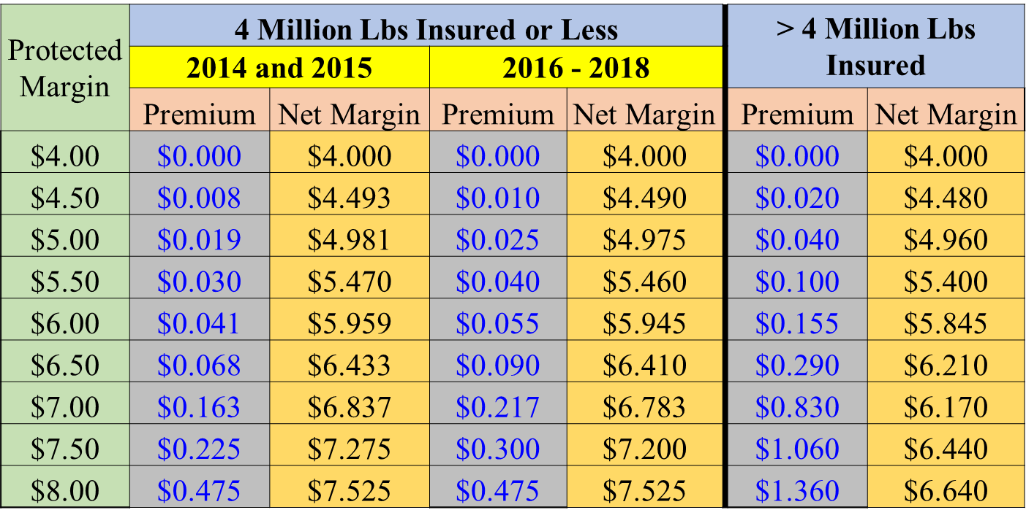
Comparison of MPP and
LGM Programs
MPP Premium Structure

Slide 19
Comparison of MPP and
LGM Programs
What prices are used in program calculations?
MPP | LGM
Average U.S. price received for All-Milk, Corn, and Alfalfa Hay (USDA, Ag Prices report) Only final prices used SBM valued at Central Illinois /Decatur (Barge) reported by USDA, AMS | Simple 3-day average of CME futures final daily settlement prices for Class III milk, Corn, and SBM Expected prices: Calculated at sign-up Actual prices: Set when futures contracts expire

Slide 20
Comparison of MPP and
LGM Programs
ρ_{All Milk, Class III} = 0.975 Avg. Basis = $1.45
Basis Std. Dev. = $0.839 Basis C.V. = 0.578

Slide 21
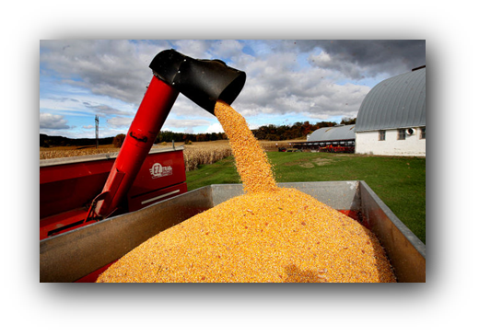
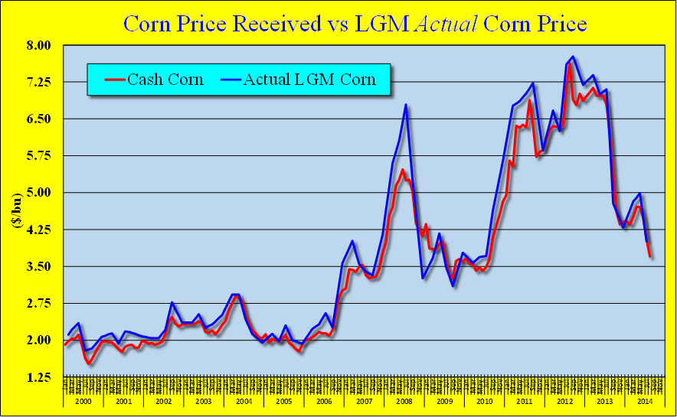
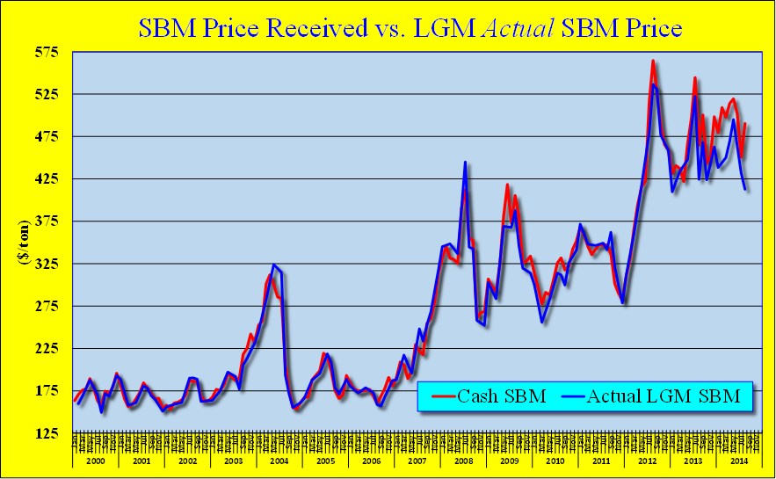
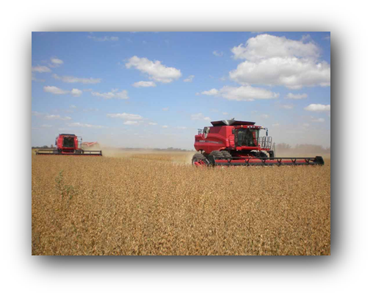
Comparison of MPP and
LGM Programs
ρ_{Cash, LGM} 0.986
Basis Characteristics
Mean −0.22
Std. Dev. 0.32
Coef. Var. 1.49
ρ_{Cash, LGM} 0.991
Basis Characteristics
Mean. 4.66
Std.Dev. 15.75
Coef. Var. 3.38

Slide 22
Comparison of MPP and
LGM Programs
What are program feed ration characteristics?
MPP | LGM
Fixed feed ration All months All operations Feed costs vary monthly All feed assumed purchased | Operation specific rations May include only purchased feed or all feed if desired Ration can vary across months under a single contract → Ration cost/cwt may vary across months within a contract even with constant feed prices

Slide 23
Comparison of MPP and
LGM Programs
When can contracts be purchased?
MPP | LGM
May be purchased once a year during designated sign-up period 2014−15: Sep 2nd – Dec 5th 2014 2016−18: June 1 – Last business day of September Once signed-up, in program until end of 2018 | Offered last business Friday monthly starting at 4:30 CDT Producers may sign up to 12 times/year conditional on funding availability Offered on first come, first served basis

Slide 24
Comparison of MPP and
LGM Programs
When are user fees (premiums) due?
MPP | LGM
2 alternatives: 25% by Feb. 1st, remainder by June 1st of insured year Fees subtracted from any forthcoming payment $100 Admin. fee due at sign-up | Premium due 11 months after purchase regardless of contract length Premium subtracted from any forthcoming indemnity

Slide 25
Comparison of MPP and
LGM Programs
To what degree are these programs subsidized?
MPP | LGM
100% subsidy @ $4.00 > $4.00: Implicit subsidy where value depends on milk and feed markets Program not self-financing Subsidy changes given market conditions, margin target and APH | Premiums subsidized where % subsidy depends on deductible $0 → 18% $1.00 → 48% $2.00 → 50% Additional subsidy for A&O to insurance providers: ≈ 20% of pre-subsidized premium

Slide 26
Comparison of MPP and
LGM Programs
How can LGM (MPP) user’s transition to use of MPP (LGM)?
MPP | LGM
Once purchased, MPP-Dairy contract holders cannot purchase LGM | 2014/15: Contract holders can transition to MPP-Dairy with coverage starting after fulfilling LGM contract After 2015: Cannot have active LGM contract for months covered by MPP contract (i.e., Dec. of sign-up year)

Slide 27
Comparison of MPP and
LGM Programs
Comparing MPP and LGM Premiums
Original IOFC Target | 2014/15 Net Margin | MPP Premiums (< 4 mil lbs) |  | LGM Premiums by Deductible Level
 |  | 2014-15 | 2016-18 | $0 | $1 | $2
$4.50 | $4.493 | $0.008 | $0.010 | $0.18 | $0.06 | $0.02
$5.50 | $5.570 | $0.030 | $0.040 | $0.22 | $0.07 | $0.03
$6.50 | $6.433 | $0.068 | $0.090 | $0.26 | $0.08 | $0.03
$7.50 | $7.275 | $0.225 | $0.300 | $0.30 | $0.09 | $0.04
$8.00 | $7.525 | $0.475 | $0.475 | $0.31 | $0.10 | $0.04
To compare probabilities: For a $7.525 net return there is an average 6% indemnity prob. under MPP for the 5 bi-month evaluations
Under LGM @$1 deductible there is a 32% indemnity probability for the 10 month contract.
Note: The LGM analysis undertaken on Sept. 24, 2014 for the upcoming Sept. contract offering. For the LGM coverage we chose the least cost contract over the Nov, 2014 – Aug 2015 period that returns a net margin equal to the 2014/15 levels shown in the 2nd column of this table. The default feed ration is used. For LGM, the unsubsidized premiums can be obtained by dividing $0 deductible values by 0.82, $1 values by 0.48 and $2 values by 0.50 . Remember the actual farm basis will differ across program.

Slide 28

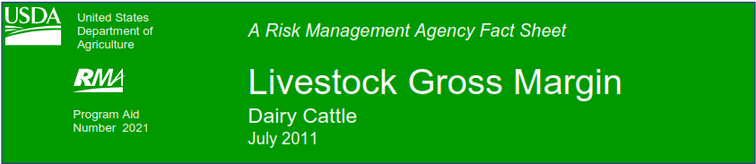
MPP vs. LGM: 2000 – 2012
Imagine both LGM and MPP were offered since Jan. 2000
Two producers
  Producer A signs up for MPP and chooses same coverage level each year ($4.50 - $8.00)
  Producer B signs up for LGM and purchases every month and insures 3 consecutive future months
      4th, 5th, 6th
      8th, 9th, 10th, etc.

Slide 29
MPP vs. LGM: 2000 – 2012
MPP Net
Indemnity ($/cwt)
LGM Net Indemnity ($/cwt)
Advance Months | Min Ration | Farm Bill Ration
1-3 | $0.09 | $0.06
2-4 | $0.17 | $0.10
3-5 | $0.25 | $0.15
4-6 | $0.29 | $0.17
5-7 | $0.31 | $0.18
6-8 | $0.30 | $0.16
7-9 | $0.30 | $0.15
8-10 | $0.29 | $0.12
Selected Coverage
$4.50 | $0.05
$5.00 | $0.08
$5.50 | $0.11
$6.00 | $0.14
$6.50 | $0.18
$7.00 | $0.21
$7.50 | $0.19
$8.00 | $0.23

Slide 30
MPP vs. LGM: 2009
MPP Net
Indemnity ($/cwt)
LGM Net Indemnity ($/cwt)
Advance Months | Min Ration | Farm Bill Ration
1-3 | $0.72 | $0.65
2-4 | $1.26 | $0.96
3-5 | $2.00 | $1.28
4-6 | $2.66 | $1.51
5-7 | $3.23 | $1.77
6-8 | $3.62 | $1.94
7-9 | $3.85 | $2.02
8-10 | $4.02 | $2.09
Selected Coverage
$4.50 | $0.42
$5.00 | $0.75
$5.50 | $1.07
$6.00 | $1.38
$6.50 | $1.72
$7.00 | $2.10
$7.50 | $2.39
$8.00 | $2.73

Slide 31
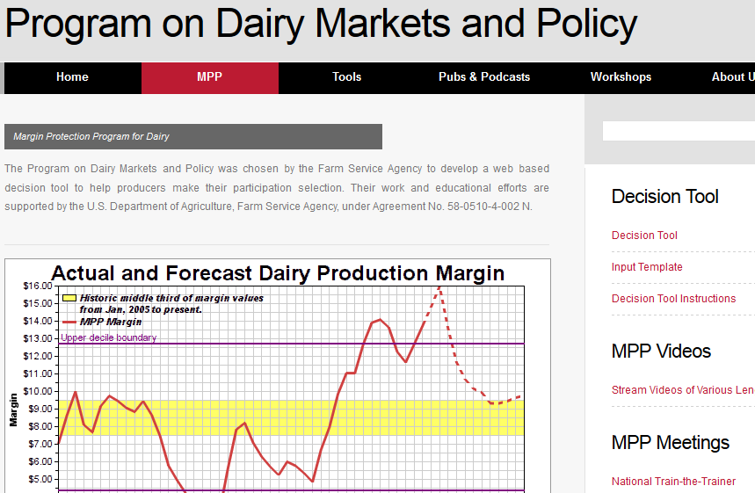
MPP Decision Tool
http://dairymarkets.org/mpp

Slide 32
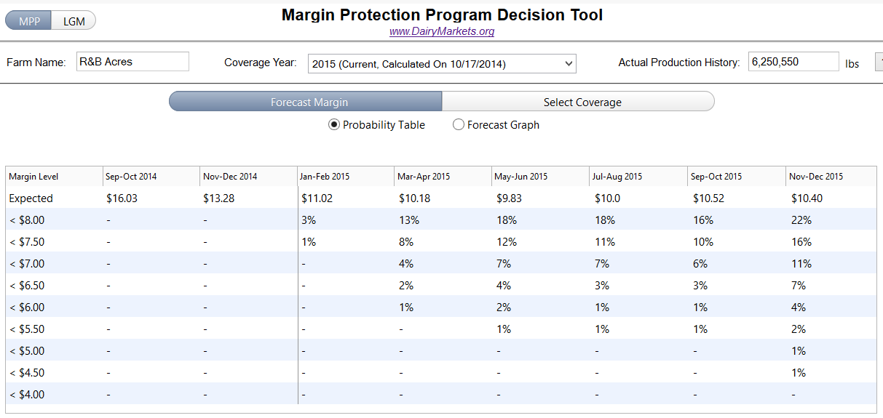
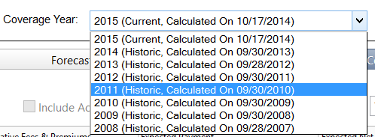
MPP Decision Tool
Enter your APH (lbs)
Default Forecast Margin view of MPP Decision Tool
Do you want to analyze MPP
or LGM-Dairy program?
Coverage Year: Default is forward looking

Slide 33
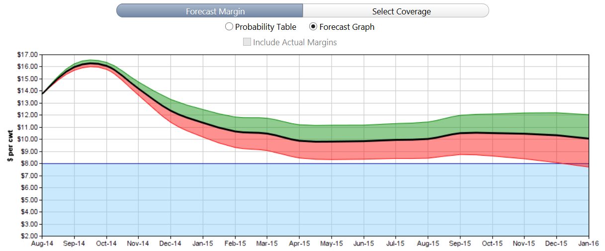
MPP Decision Tool
Forecast Graph view of MPP Tool
Margin with a
25% prob. of
being above
forecast
Forecast
Margin Value
Expected
Margin
Dec ʹ15 Margin range with 50% probability of occurrence
Margin with a
25% prob. of
being below
forecast
Note: Based on futures and options data as of 10/17/2014

Slide 34
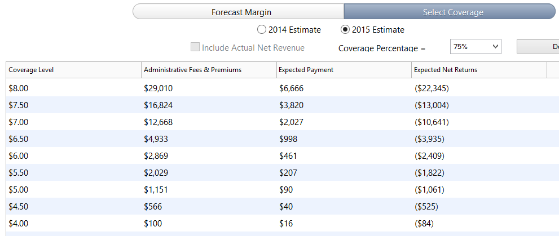

MPP Decision Tool
Select Coverage view
Percent of Milk Insured
$100 + Premium
Expected Indemnity
Expected Indemnity − (Fee + Premium)

Slide 35
MPP Participation Decision
The decisions faced by a potential MPP enrollee the same as current enrollees
Plus, need to make a decision whether to participate at all
  Should investigate use of LGM given one can’t enroll in both programs and permanent MPP sign-up
  If LGM never in decision set then should at-least join and choose $4.00 protection
    $100 annual cost

Slide 36
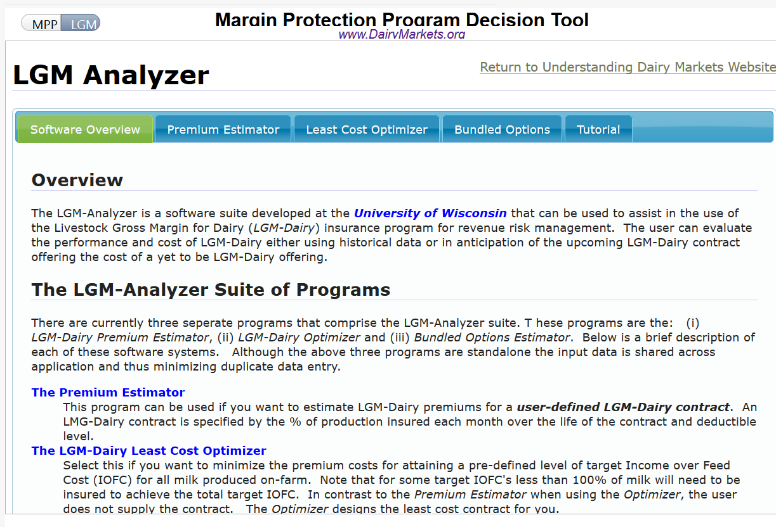
MPP Participation Decision
Use LGM-Analyzer

Slide 37







Contact Information
Professor Brian W. Gould
bwgould@wisc.edu (608)263-3212
Understanding Dairy Markets website: future.aae.wisc.edu
Dairy Marketing and Policy (DMaP) group MPP website: www.dairymarkets.org/mpp
FSA Website: www.fsa.usda.gov/mpptool

